Slide 1

Drowsiness Detection
By:-
Abhinav Jain
Vinit Sharma
Palak Sharma
Anubhav Sharma

Slide 2

Problem Occur…!!!
Nowadays the driver safety in the car is important thing. Cop wants to avoid accident done by drowsy peoples.
Nowadays another incident happen when a drowsy person try to robbed hotel reception or bartenders. The hotel staff wants to avoid the robbery.

Slide 3


What we have for solution?
See all the problems occur over We all team members come together and get to the solution to develop an alarm system that detects the person and instantly detects whether the person is drowsy or not. We use the Artificial Neural Network and train it to recognize the facial expression and eye activity of the human.
The Model is trained over many images now when it comes to the work it starts watching over the human and detects its facial expression also it detects the eye activity of the human. When the score of the human goes above 16 the alarm is triggered and the screen becomes red.
Basic
Artificial Intelligence is used in many places to detect and predict many things like in this project we use AI Model to specifically learn about Drowsy person and detect them.

Slide 4
Introduction
Signs of Drowsy person. If you notice them, it's time to take urgent action.
Reducing in vision - Eyes are not able to see properly
Reducing of attention - The mind and the body is not able to coordinate with each other.
Lack of concentration and tension on face.
Artificial Neural Network work on the concept of learning things and assuming or predicting the output. Here by the given above signs we can see that these signs can be learn by a Neural Network and can easily detect about the person. So, we build a model which capture the live real time image of the person and tell whether the person is drowsy or not.

Slide 5
Hardware Use
The hardware required to run the software are as follow:
Intel i3 7th gen processor or Above
Nvidia Geforce 900M series of Above/AMD Risen 3 or above
Web Camera
Tip
Artificial Intelligence Model works on Graphical Processing Unit. This means the more GPU we use the more accurately AI learn about the dataset in less time.

Slide 6

Software and Libraries Use
Windows OS/ Linux OS/ Mac OS
Python 3.7.6 (Above)
Libraries Require:
OS Library
Numpy Library
Keras Library
Shutil Library
Random Library
Matplotlib Library
Pygame Library
OpenCV Library
Time Library

Slide 7
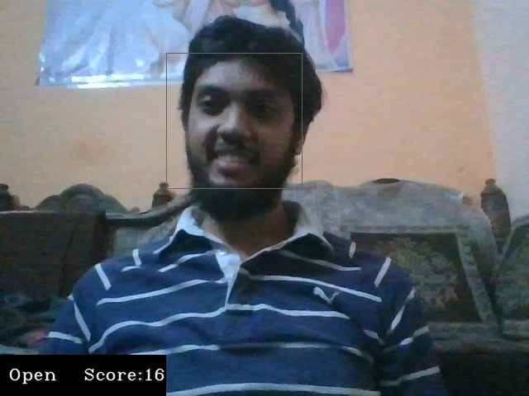
Testing & Examples
The tests were conducted in various conditions including:
Different lighting conditions.
Drivers' posture and position of the automobile drivers face.
Drivers with spectacle

Slide 8
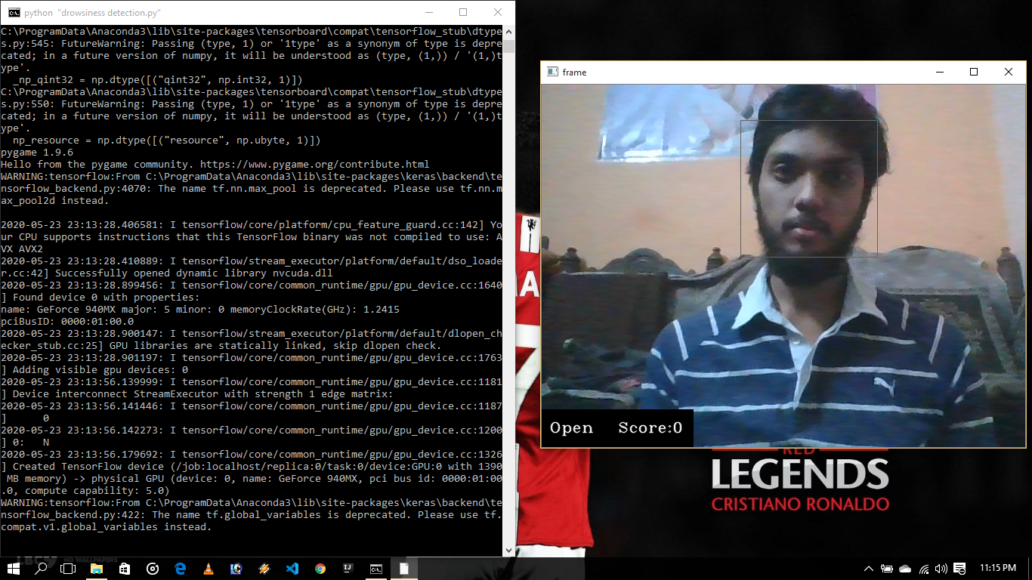
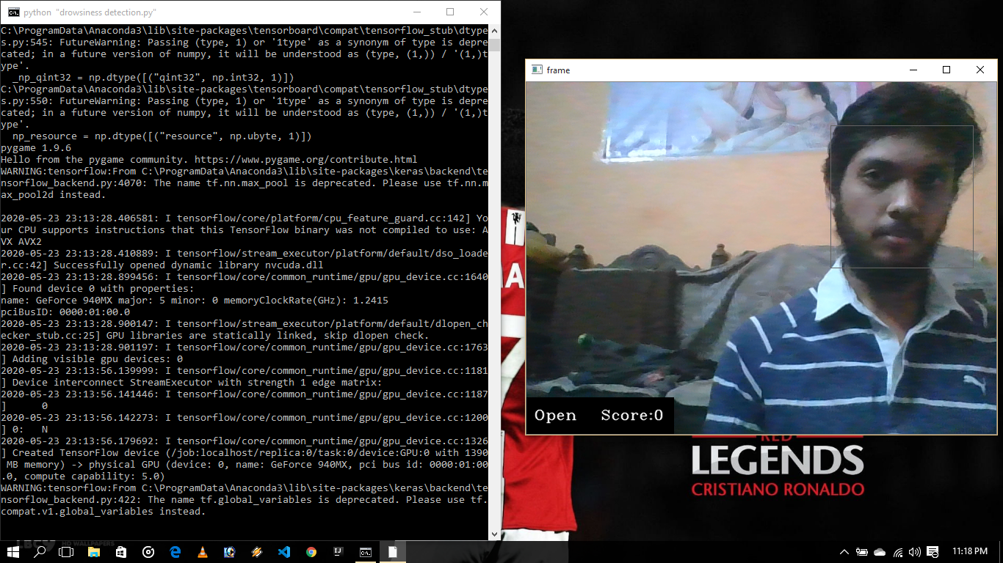
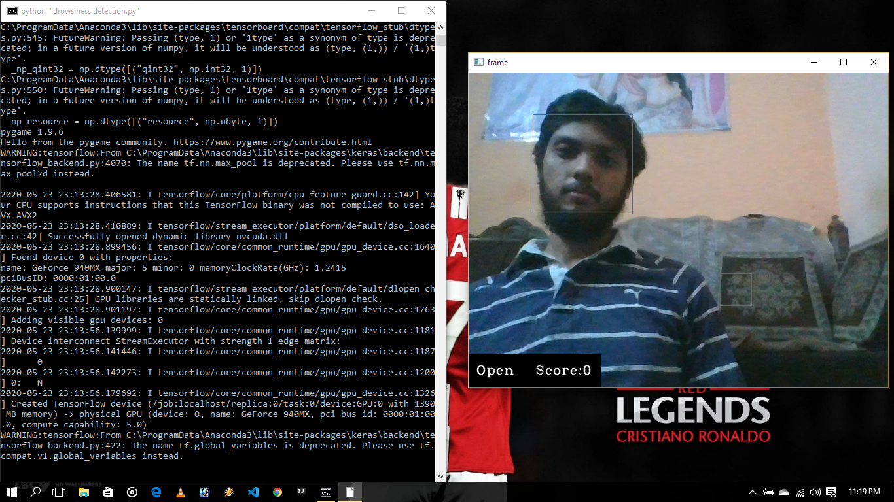
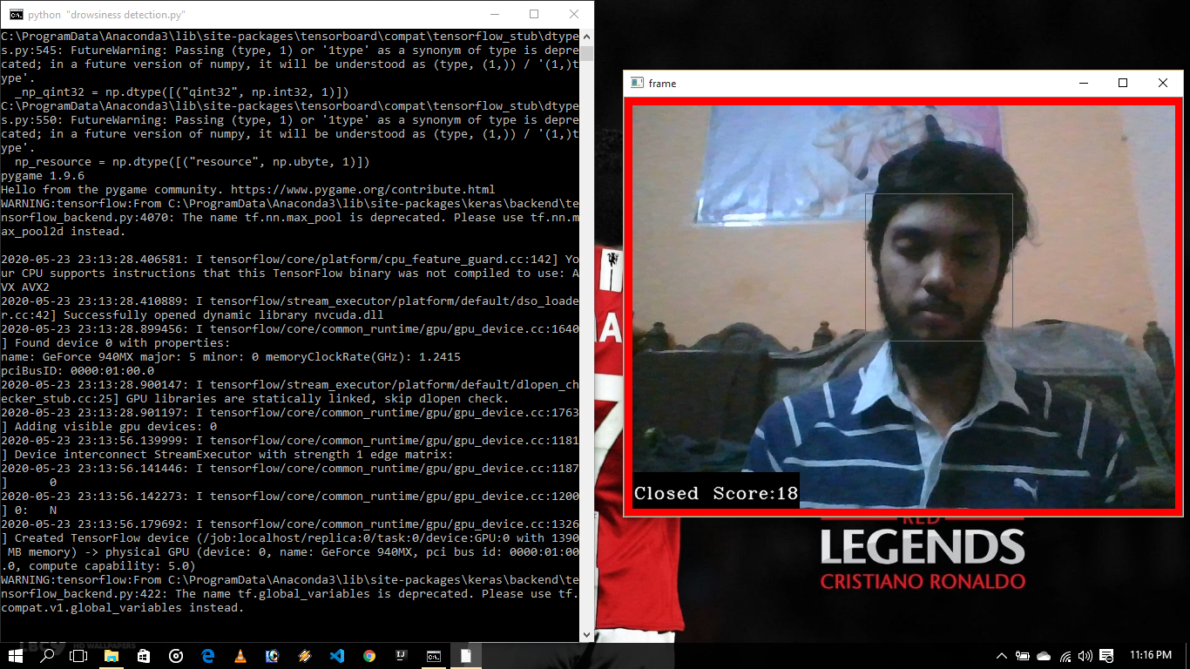
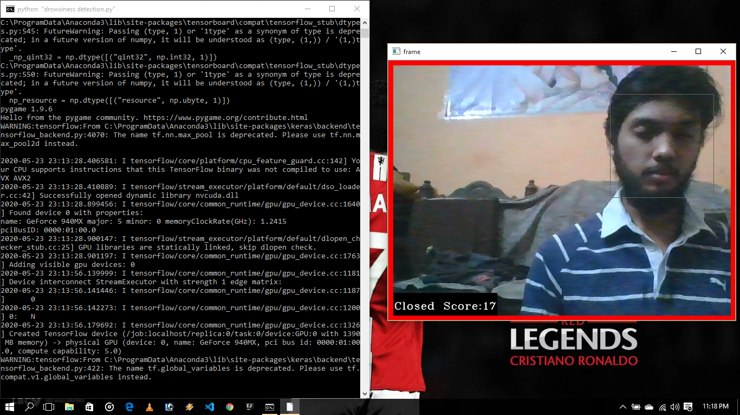
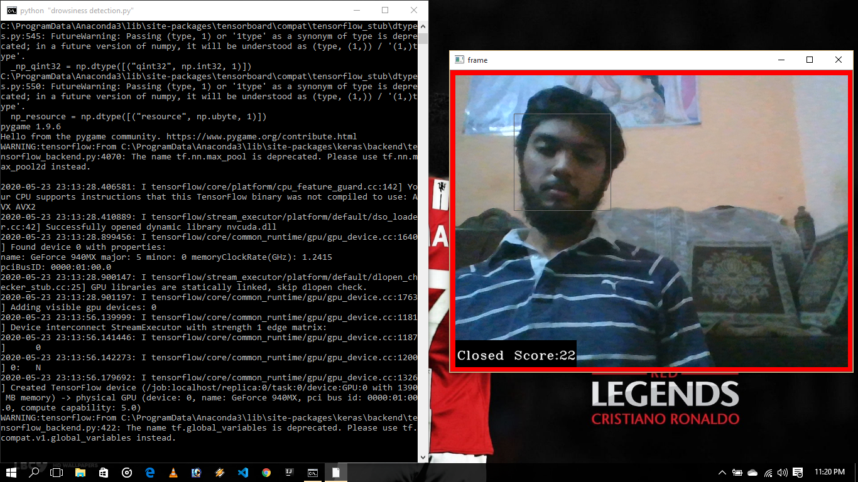
Eye Open(Center Position)
Eye Open (Left Position)
Eye Open (Right Position)
Eye Close (Center Position
Eye Close (Left Position)
Eye Close (Right Position)

Slide 9
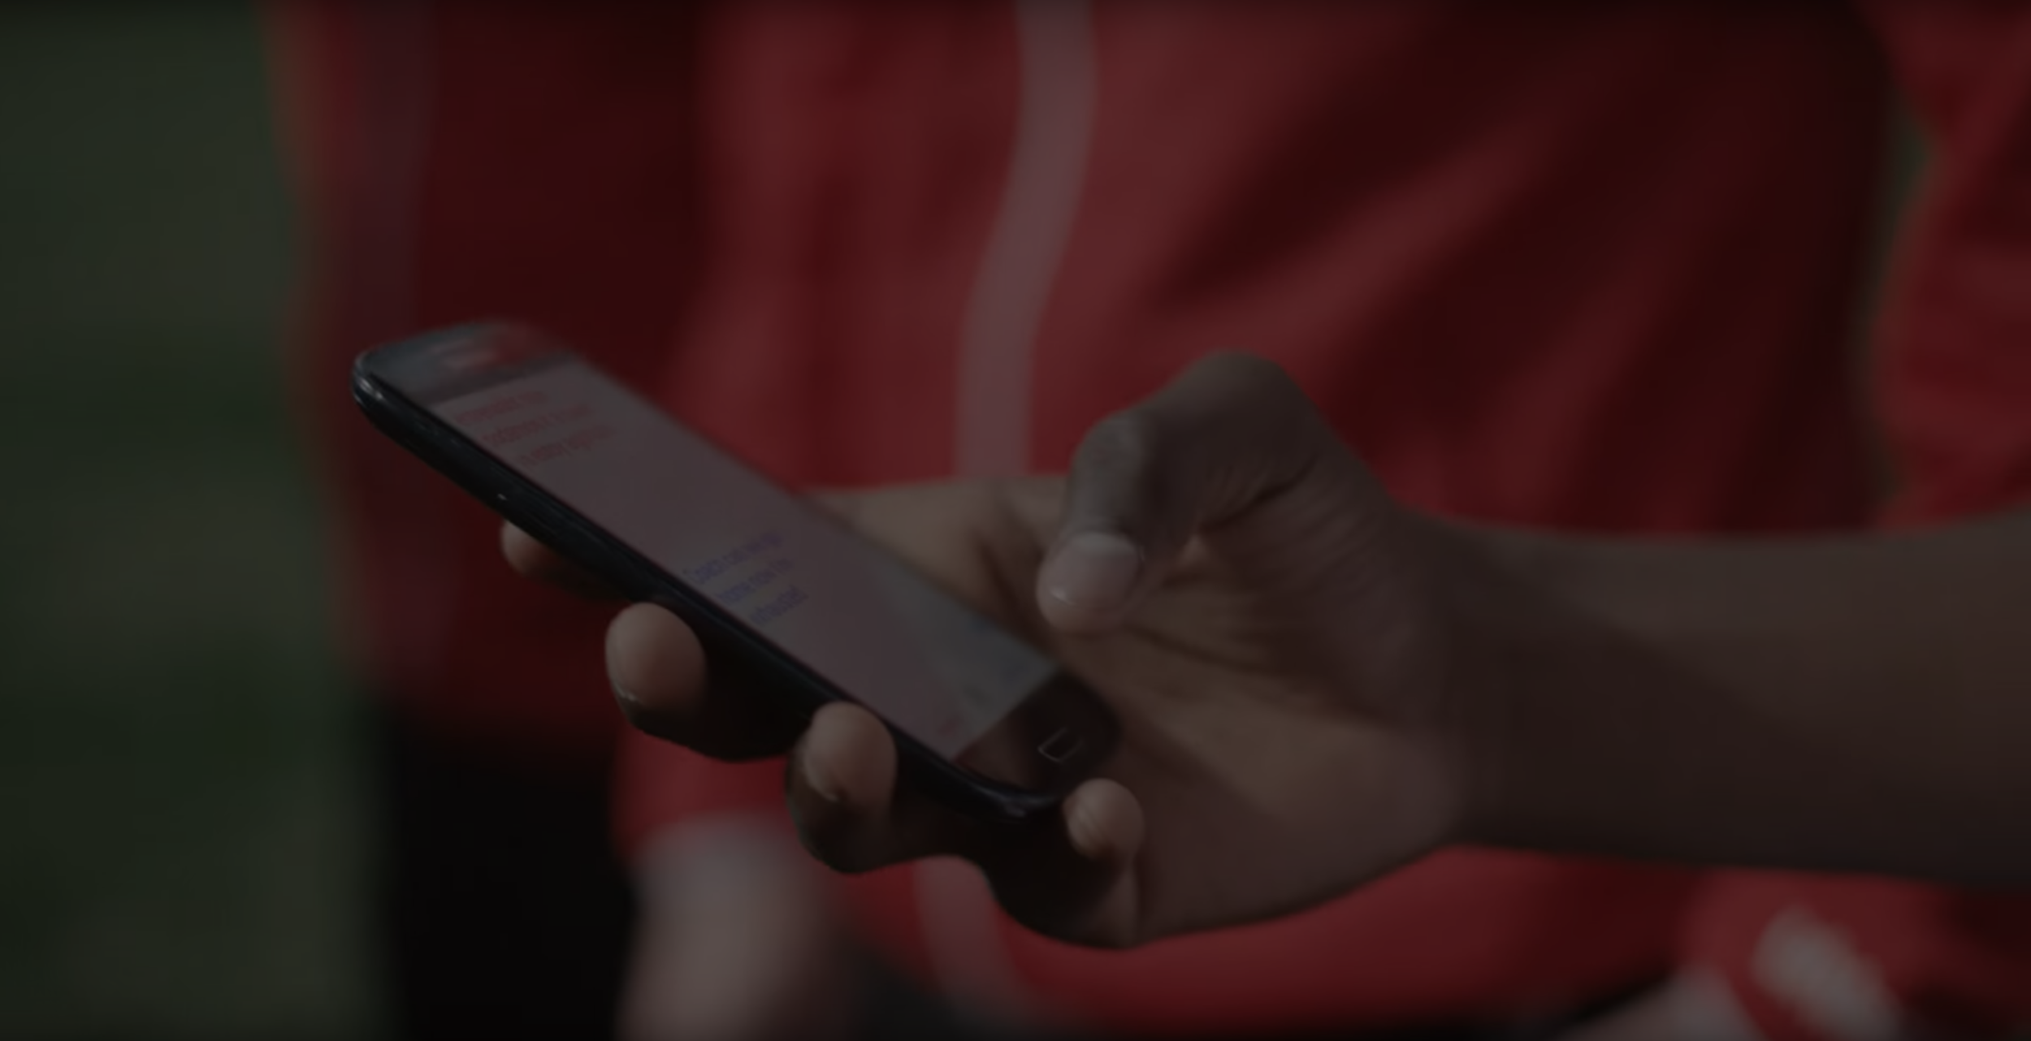
Future Scope
Standalone product: It can be implemented as a standalone product, which can be installed in an automobile for monitoring the automobile driver.
Smartphone application: It can be implemented as a smartphone application, which can be installed on smartphones. And the automobile driver can start the application after placing it at a position where the camera is focused on the driver
Tip
Ideally, speak of people in very different situations, but where each could benefit from your solution.

Slide 10
Conclusion
The drowsiness detection developed is capable of detecting drowsiness in a rapid manner. The system which can differentiate normal eye blink and drowsiness which can prevent the driver from entering the state of sleepiness while driving. It also helps Hotel managers and bartenders to avoid nuisance at hotels and bars. It also helps cops to avoid accidents by frequently tracking the drowsy person on many signals

